Slide 1

Cloud based movie streaming platform
Tanim Ahmed 2312597042
Mustakim Ahmed Hasan 2421349042
MD. Nafiz Al Mamun 2232050642
Ahamed Osman Asif 2031080642
Notes:
Group number: 1 Group Member names: Tanim Ahmed 2312597042
Mustakim Ahmed Hasan 2421349042
MD. Nafiz Al Mamun 2232050642
Ahamed Osman Asif 2031080642

Slide 2

Project Overview
A similar web based video streaming platform similar to Netflix, Amazon Prime Video or iQIYI
Allows users to search, browse and watch movies/shows
Provides personalized user experience
Building platform using web technologies
Notes:
Group number: 1 Group Member names: Tanim Ahmed 2312597042
Mustakim Ahmed Hasan 2421349042
MD. Nafiz Al Mamun 2232050642
Ahamed Osman Asif 2031080642

Slide 3
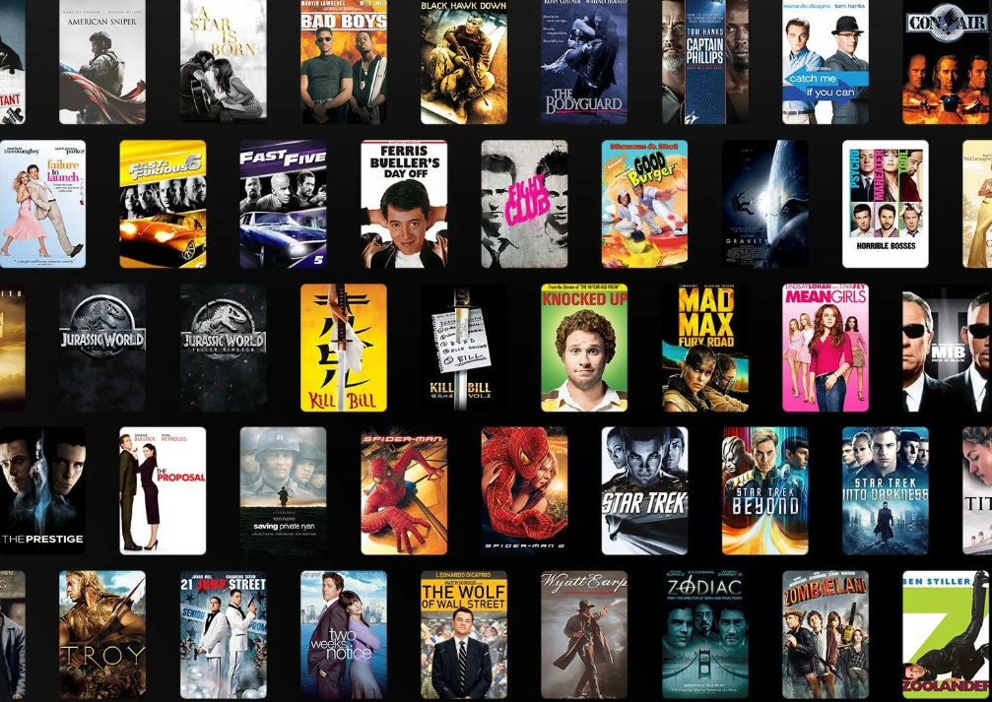
Problem Statement
Traditional TV lacks personalization and on demand flexibility.
Modern streaming platforms are complex, large scale and expensive.
Users often pay for multiple subscriptions to access different content in multiple sites
This project aims to build a simplified streaming system for learning systems.
Notes:
Group number: 1 Group Member names: Tanim Ahmed 2312597042
Mustakim Ahmed Hasan 2421349042
MD. Nafiz Al Mamun 2232050642
Ahamed Osman Asif 2031080642

Slide 4
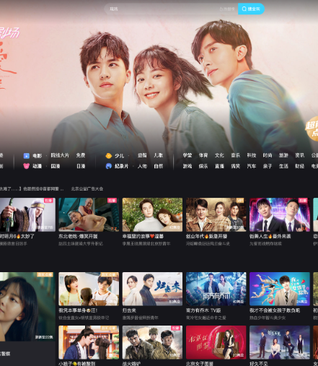
Project Objectives
Developing a responsive streaming web application platform
Implementing user authentication system
Create movie browsing and search functionality
Store and manage user data in database, for example: if a user creates an account, particularly in MySQL
Will be similar to real world streaming platform features Tencent Video, iQIYI or Youku or Amazon Prime Video
Notes:
Group number: 1 Group Member names: Tanim Ahmed 2312597042
Mustakim Ahmed Hasan 2421349042
MD. Nafiz Al Mamun 2232050642
Ahamed Osman Asif 2031080642

Slide 5
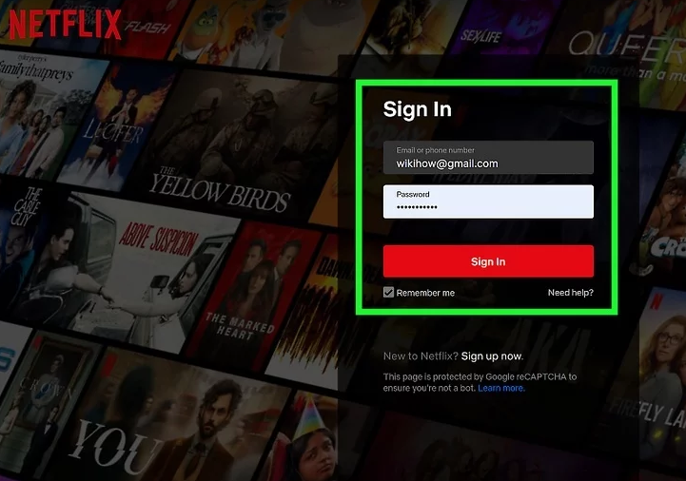
Features of the system
User point of view:
Users can do registration(creating an account) and login and then browse movies or TV shows. It should have search functionality and one can watch trailer/video as well as add to watchlist.
Admin point of view:
Admin can add or delete movies. They can also manage users and upload movie data.
Notes:
Group number: 1 Group Member names: Tanim Ahmed 2312597042
Mustakim Ahmed Hasan 2421349042
MD. Nafiz Al Mamun 2232050642
Ahamed Osman Asif 2031080642

Slide 6
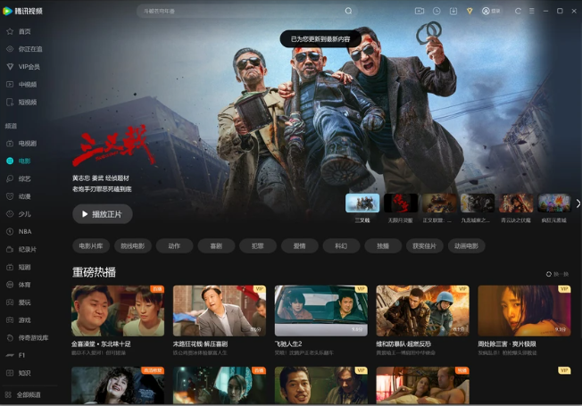
System Architecture
Frontend will be in HTML, CSS and JavaScript
And backend will be in FastAPI
And database in MySQL
There may be API integration
Database will have users table and movies table as well as watchlist table
UI Design will have homepage screenshot and a login page. It will also have movie details page as well as watchlist page
Notes:
Group number: 1 Group Member names: Tanim Ahmed 2312597042
Mustakim Ahmed Hasan 2421349042
MD. Nafiz Al Mamun 2232050642
Ahamed Osman Asif 2031080642

Slide 7

Question are welcomed
Notes:
Group number: 1 Group Member names: Tanim Ahmed 2312597042
Mustakim Ahmed Hasan 2421349042
MD. Nafiz Al Mamun 2232050642
Ahamed Osman Asif 2031080642

